Slide 1
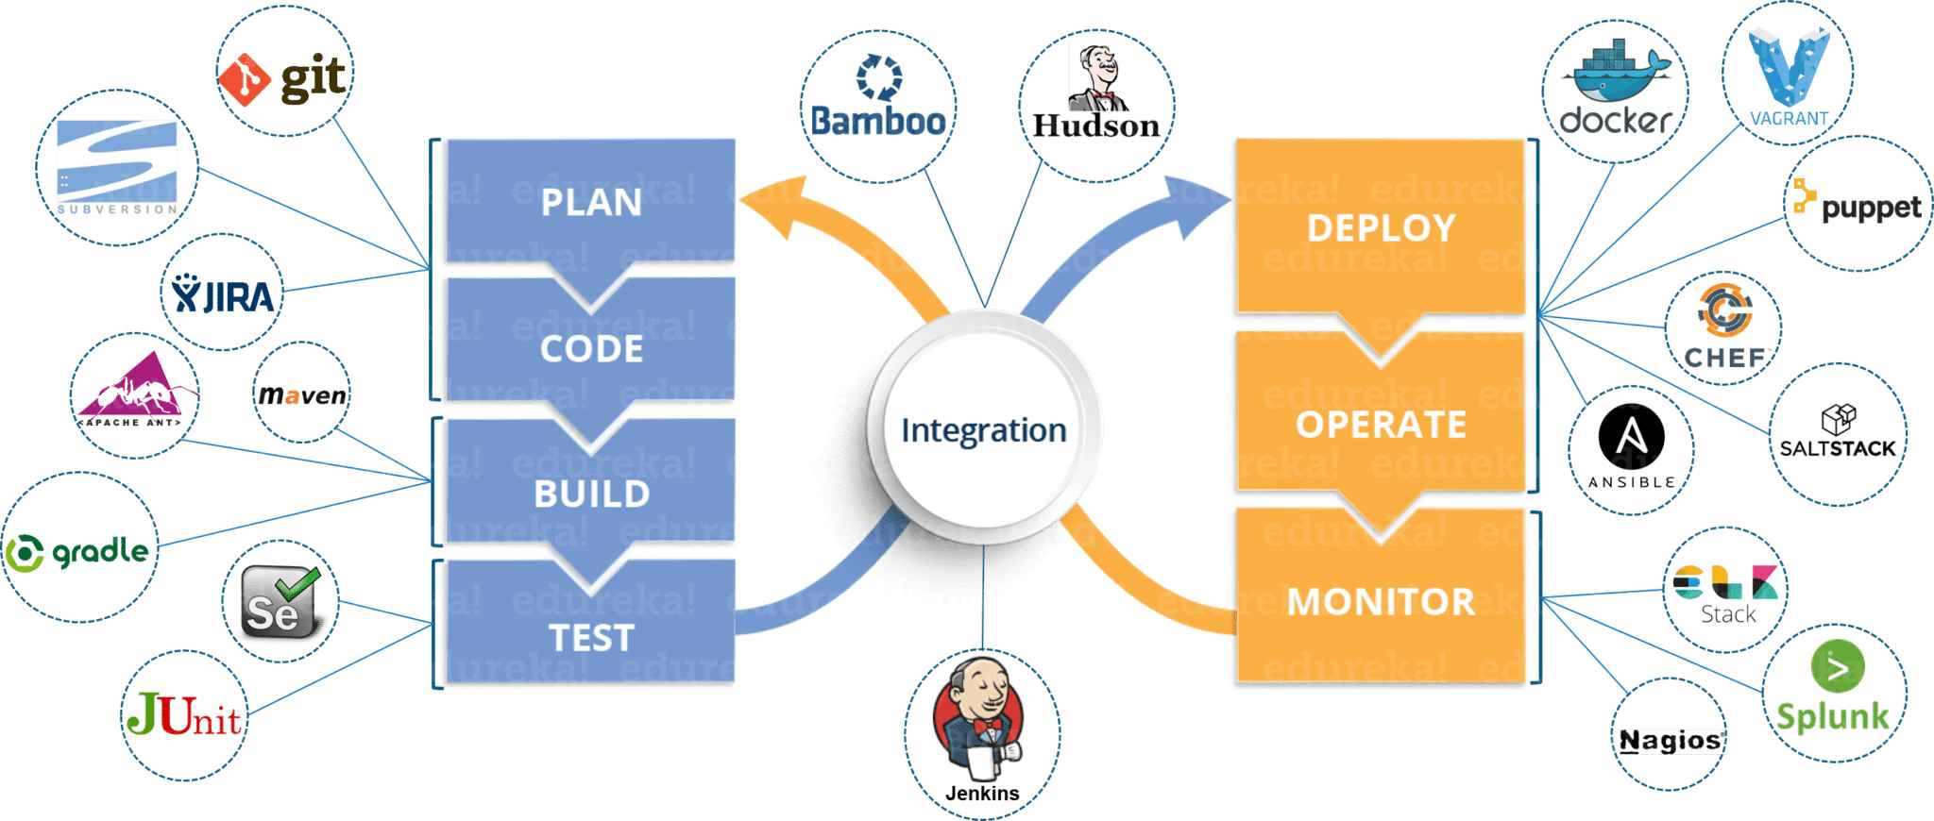

Slide 2
Benefits of Using AI in DevOps
Use cases of AI in DevOps
Faster delivery cycles
Proactive issue resolution
Reduced manual effort
Improved software quality
Smarter resource usage
Handles complexity, large data volumes, and faster troubleshooting needs
AI can detect anomalies, automate tasks, and improve decision-making
Incident prediction and root cause analysis
Auto-healing based on ML
Alert noise reduction
Proactive monitoring with pattern detection

Slide 3
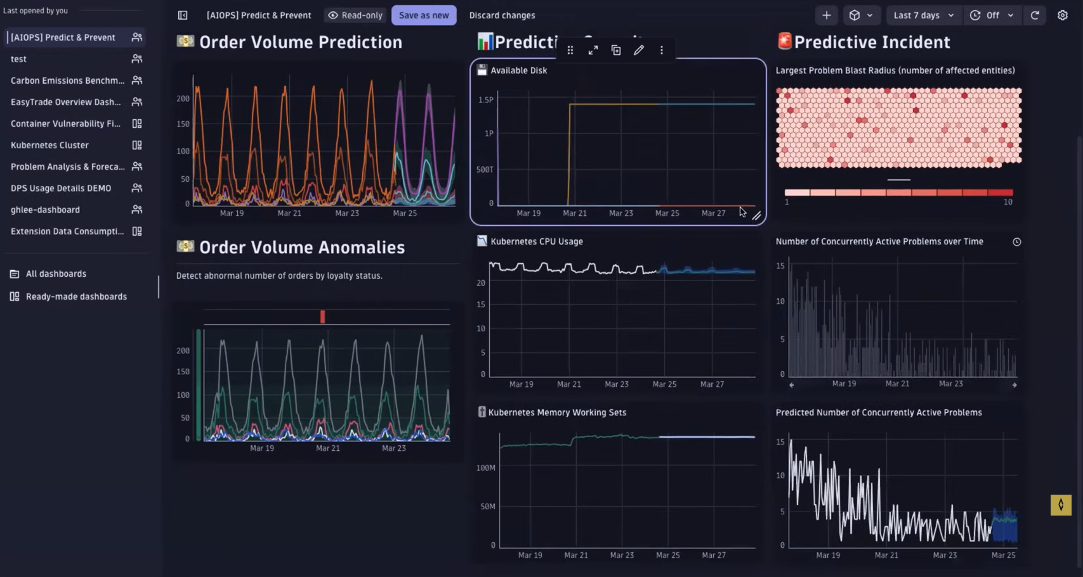

Slide 4
Using Isolation Forest for Anomaly Detection in DevOps Logs
An unsupervised machine learning algorithm.
Designed to detect anomalies by isolating outliers.
Works well with high-dimensional datasets, including log data.
DevOps logs generate large volumes of semi-structured data.
Manual monitoring is time-consuming and error-prone.
Isolation Forest can flag abnormal patterns.
Automatically detect unusual behavior in logs.
Reduce MTTR (Mean Time to Resolution).
Increase system reliability and observability.
Scalable across multiple microservices and environments.

Slide 5
AI Agents Used in DevOps Workflow
CrewAI Multi-agent framework for building collaborative AI agents tailored for DevOps tasks.
Agentic CLI Command-line AI assistant that helps automate routine terminal tasks using LLMs.
kubectl-ai AI-powered CLI tool that translates natural language into kubectl commands with explanations.
GitHub Copilot Workspace AI coding assistant integrated into your IDE for generating code, refactoring, and navigating large codebases.
Qwiet AI Security-focused AI that scans code for vulnerabilities and integrates with CI/CD pipelines.

Slide 6
CreAI in DevOps Automation
🚀 Kubernetes Files Generation
Automated YAML Generation
creating/Genrating Documentations like Kubernetes
📚 Internal Document Q&A
Smart Document Ingestion
Instant Team Q&A

Slide 7
Agentic CLI – AI for Command-Line Productivity
1. Natural Language to Terminal Commands
Converts plain English into accurate shell commands (e.g., bash, zsh).
Great for users who aren't fluent in CLI syntax.
2. Multi-Step Task Automation
Chains multiple CLI commands to complete workflows (e.g., setup a project, monitor logs, deploy services).
Supports agent-like behavior with memory and task planning.
3. Reduces Human Error in Terminal
Explains commands before running them, helping avoid risky operations.
Acts as a safe assistant for DevOps engineers and SREs.
4. Customizable and Open Source
Easily integrates into existing toolchains or custom workflows.
Can be fine-tuned or extended for specific environments.

Slide 8
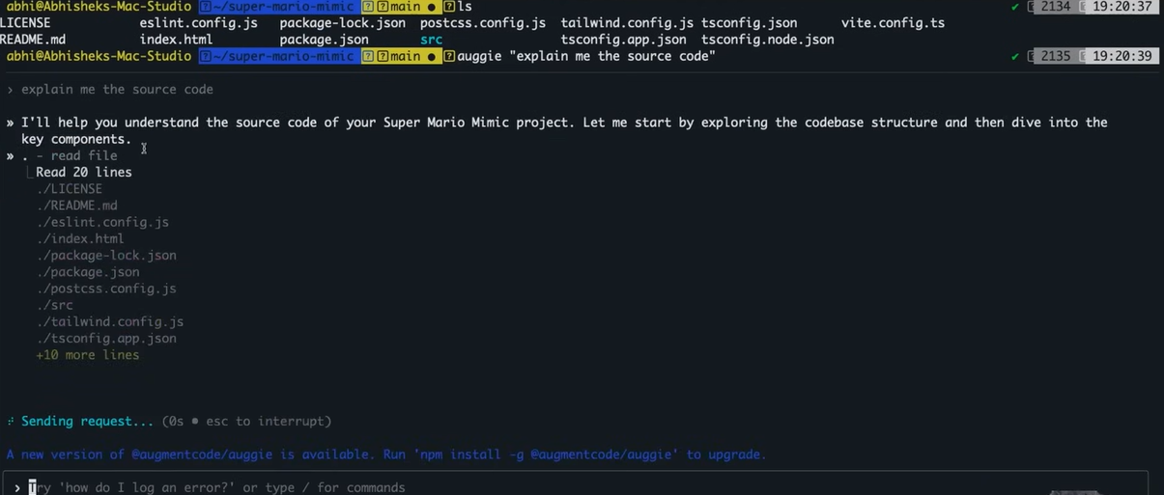
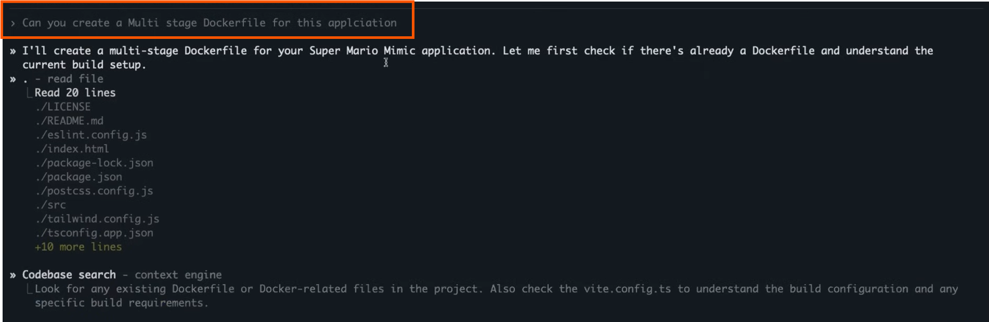

Slide 9
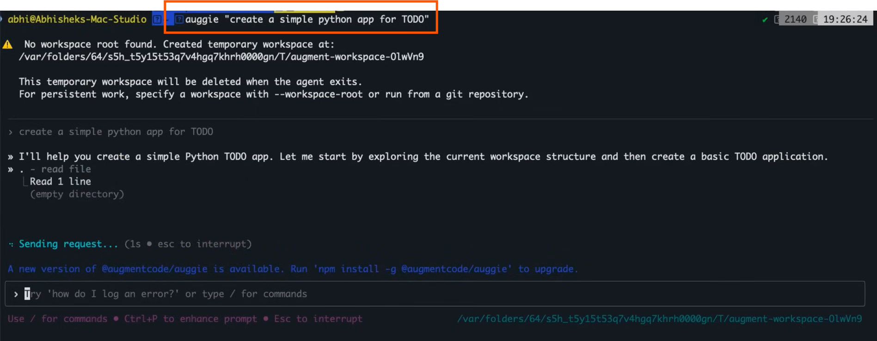

Slide 10
kubectl-ai in DevOps
Converts plain English instructions into accurate kubectl commands.
Reduces the need to memorize complex Kubernetes syntax.
Helps junior engineers interact with clusters safely and efficiently.
Example:
🗣️ “Get all pods in the production namespace that are in a CrashLoopBackOff state”
💻 kubectl-ai →
kubectl get pods -n production --field-selector=status.phase=CrashLoopBackOff

Slide 11
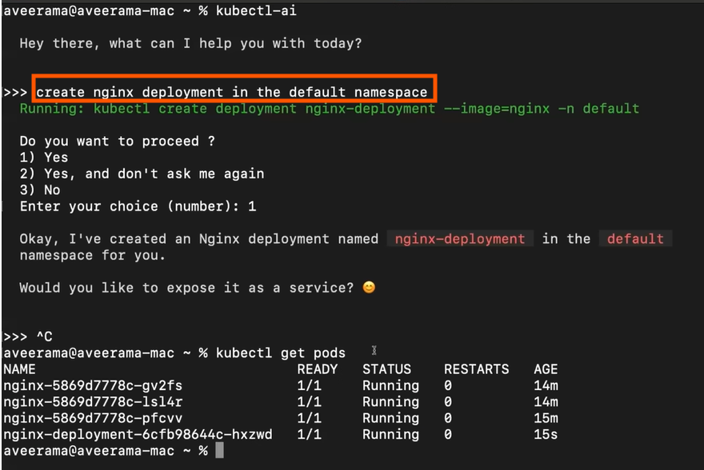
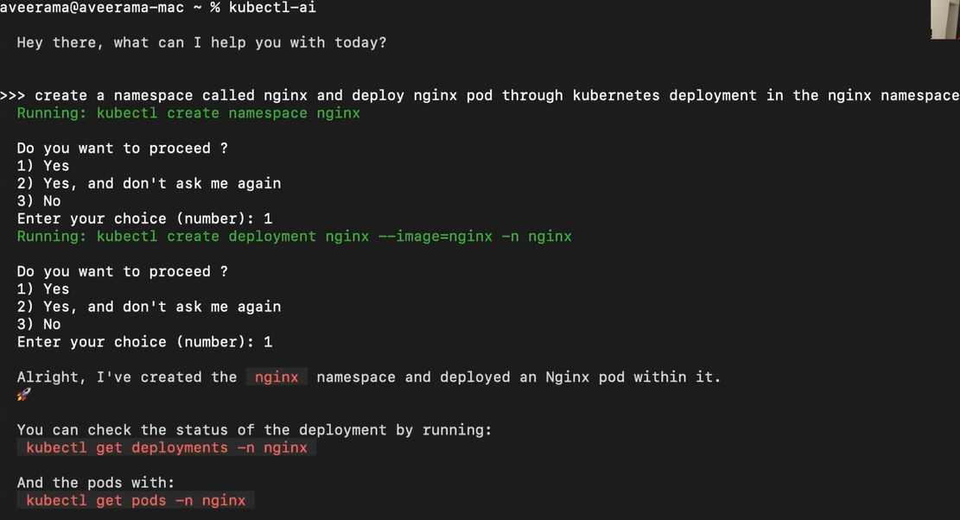
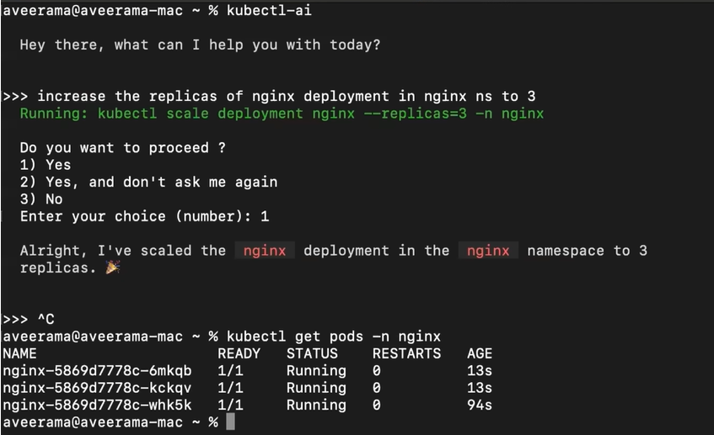

Slide 12
GitHub Copilot Workspace
🧪 Demo Suggestion for the Slide
Scenario: “Add logging to all API endpoints in a Flask app”
Copilot Workspace Can Do:
Read all existing routes across files.
Suggest where and how to insert consistent logging.
Generate code snippets with minimal input.
AI-Powered Project Understanding & Code Generation
Understands the entire codebase context across files and folders.
Helps developers with:
Writing new functions or modules from natural language descriptions.
Explaining existing code and logic.
Navigating large codebases effortlessly.
Copilot Workspace uses Codex (or a successor model) under the hood — but they are not the same thing. Codex is the engine; Copilot Workspace is the car.

Slide 13
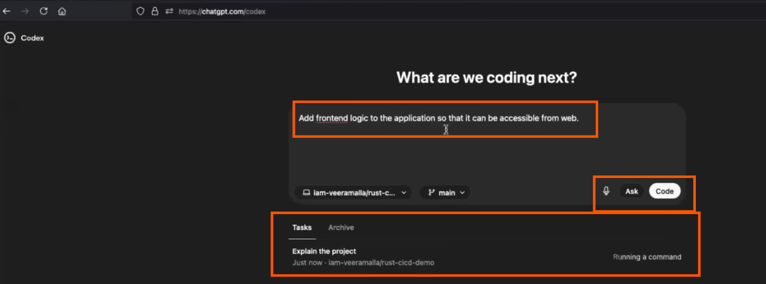
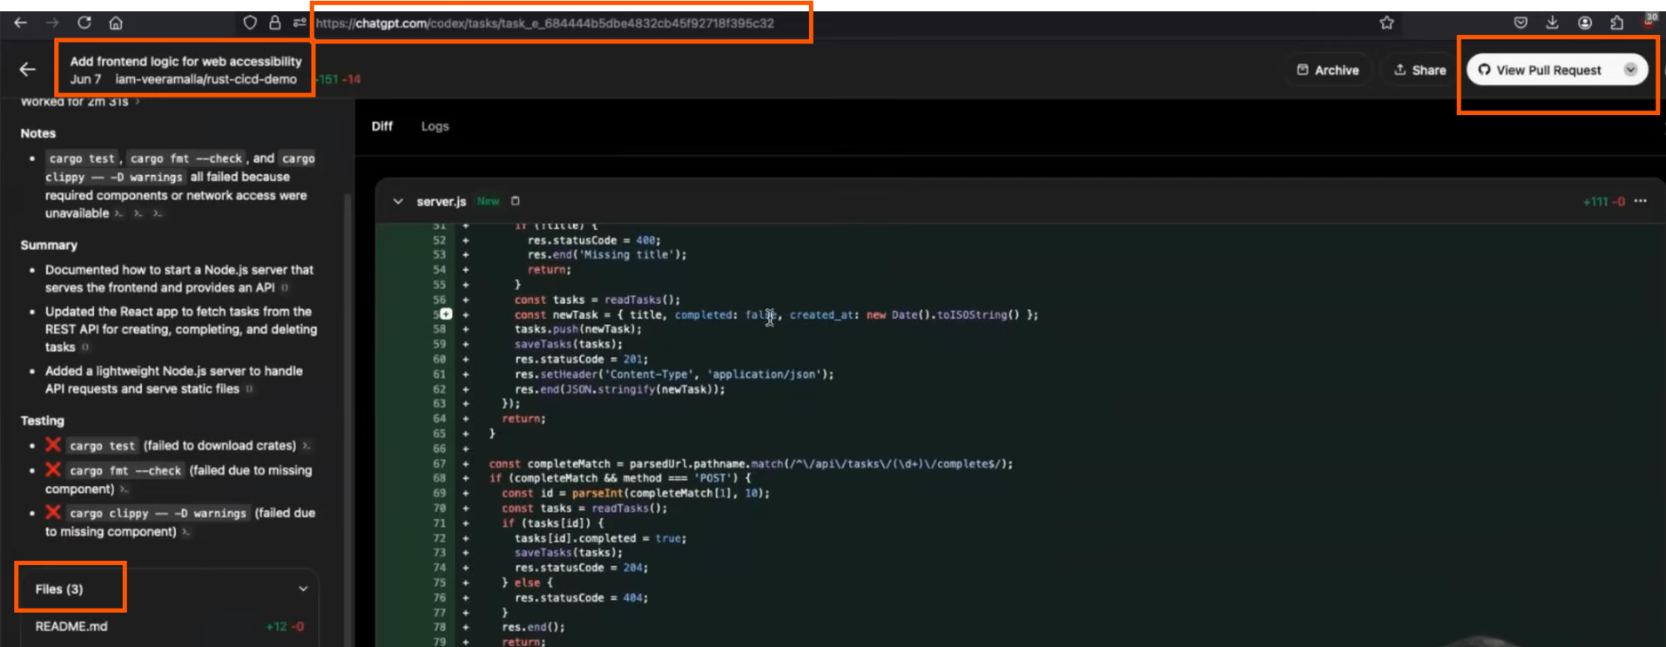

Slide 14
Qwiet AI – AI-Powered Code Security
1. Secure Code During Development
Scans code in real-time for vulnerabilities as developers write it.
Catches common issues like SQL injection, XSS, hardcoded secrets, etc.
2. Integrates with CI/CD Pipelines
Automatically scans every pull request or commit.
Provides security feedback before deployment.
3. Language-Aware & Contextual Analysis
Understands code structure (AST-level scanning).
Avoids false positives by considering how the code actually runs.
4. Developer-Friendly Remediation
Suggests secure code fixes directly in the IDE or pull request.
Provides explanations and context for each security finding.

Slide 15
https://qwiet.ai/platform/autofix/

Slide 16
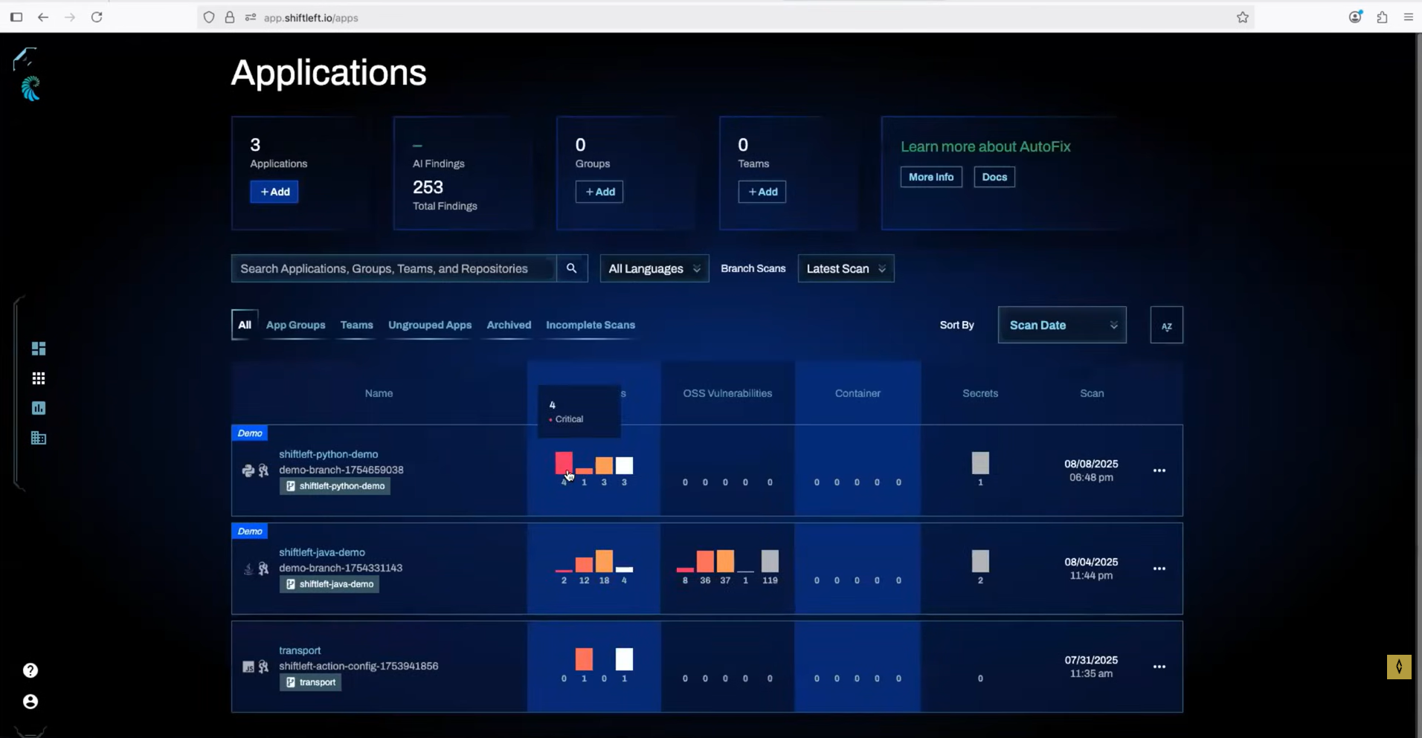

Slide 17
Q&A
Thank you!

